Slide 1
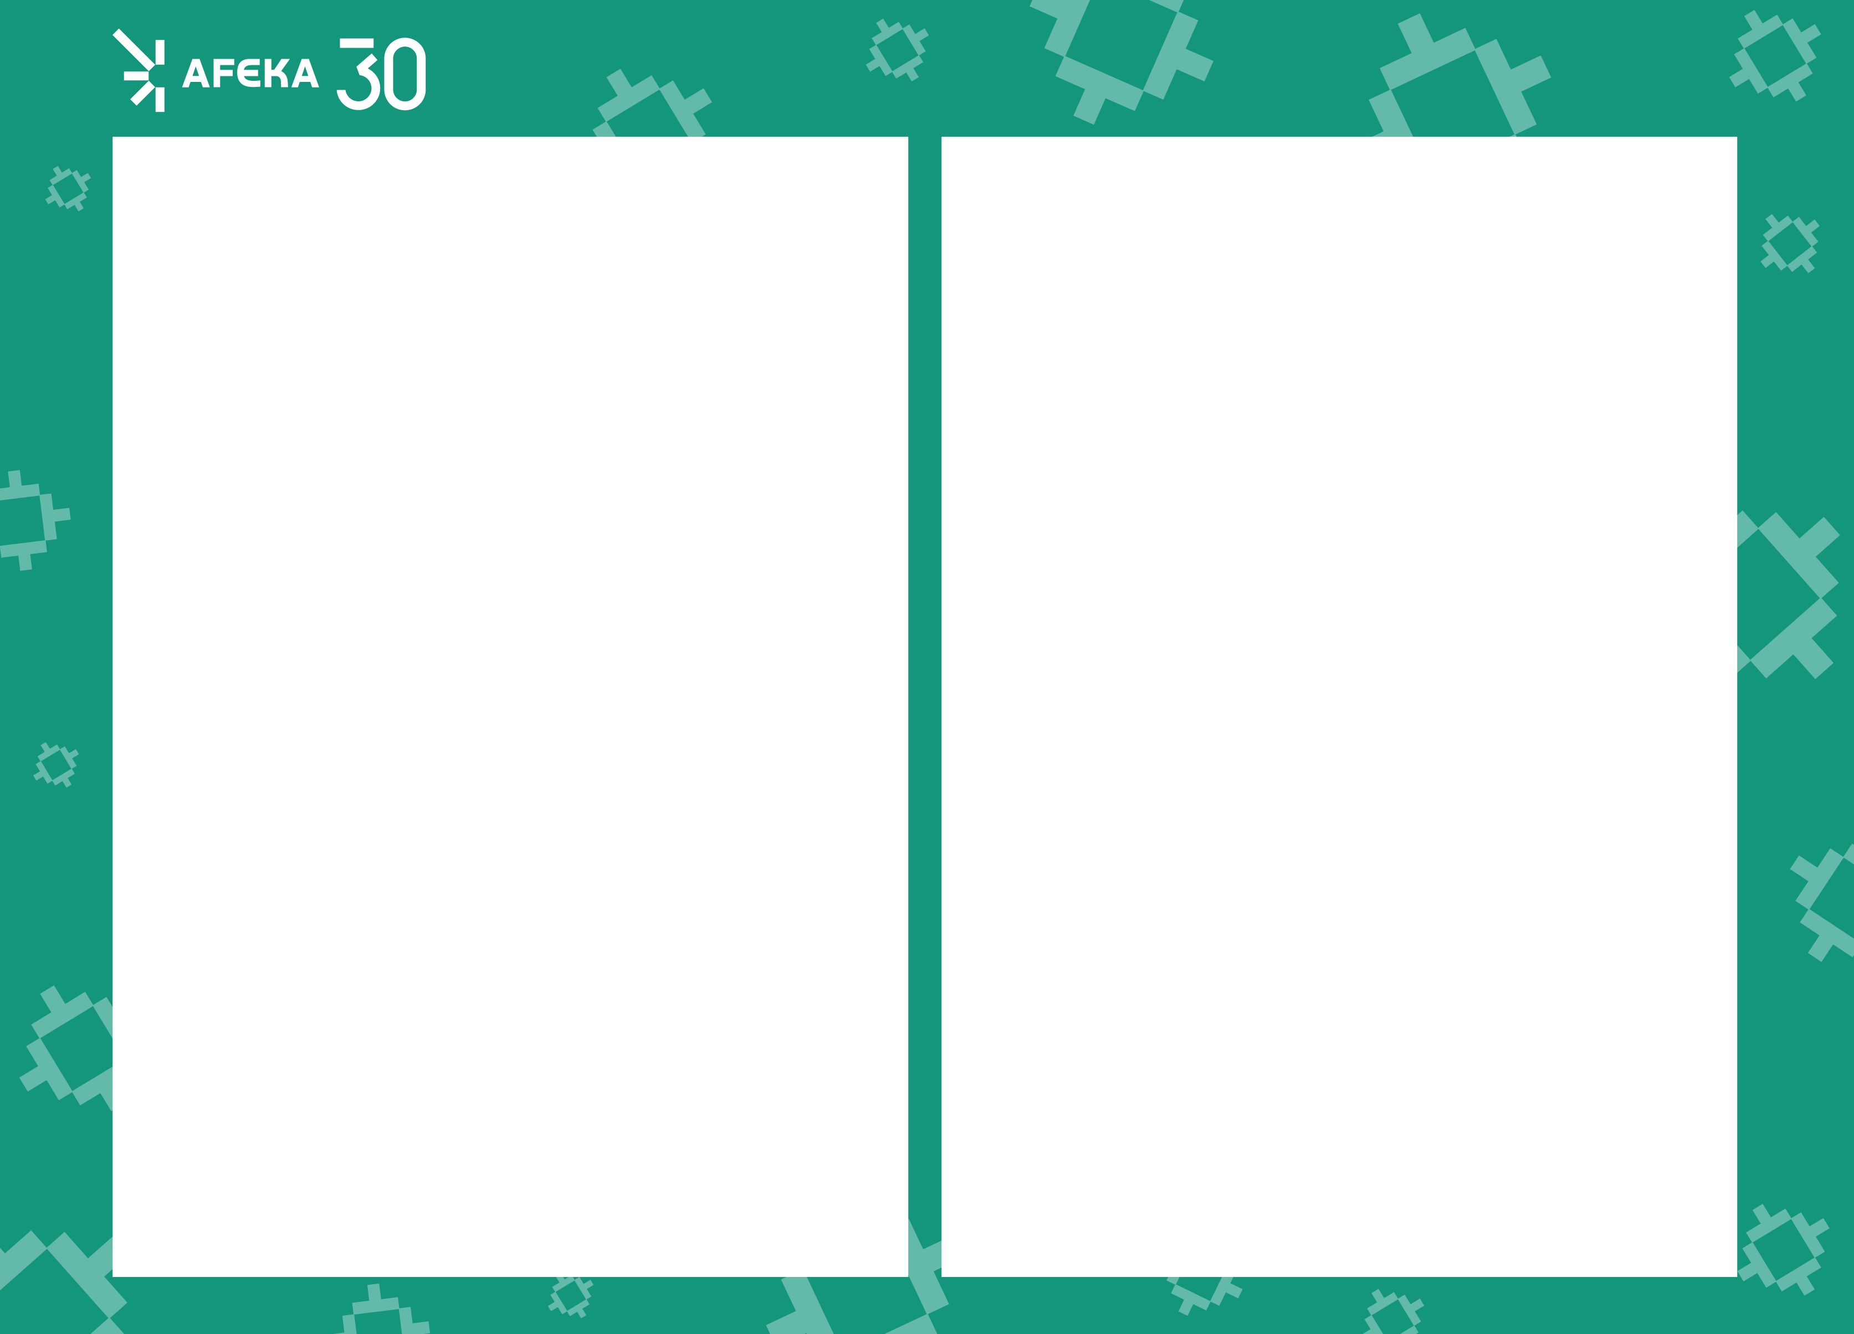
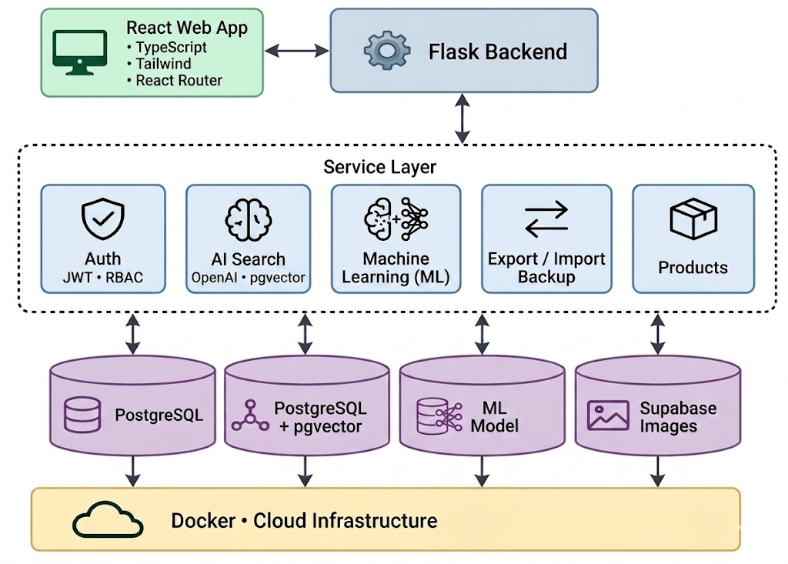

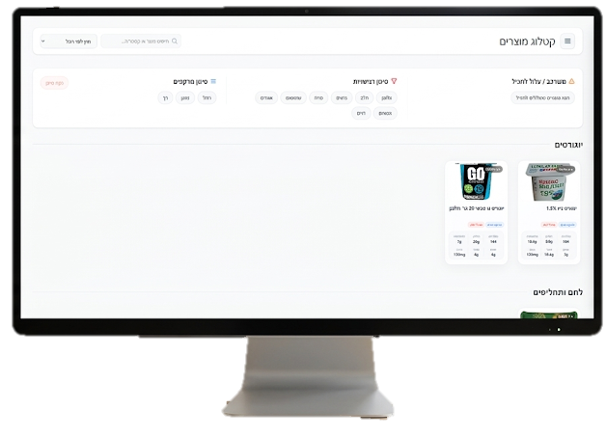
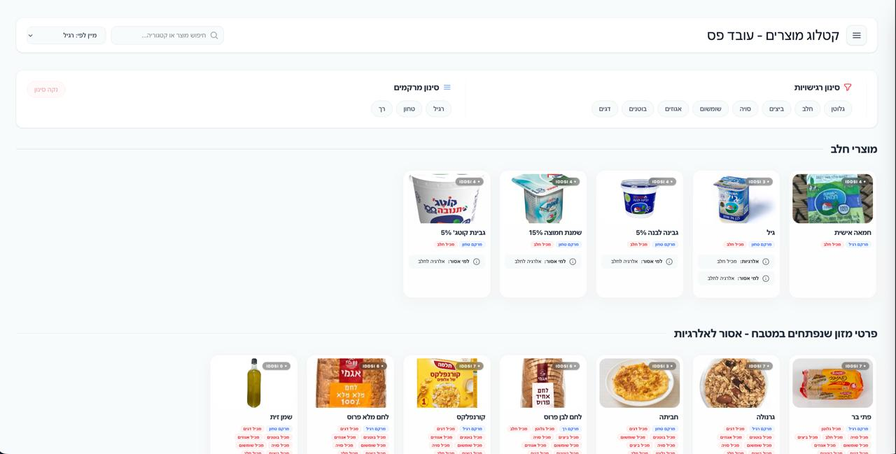
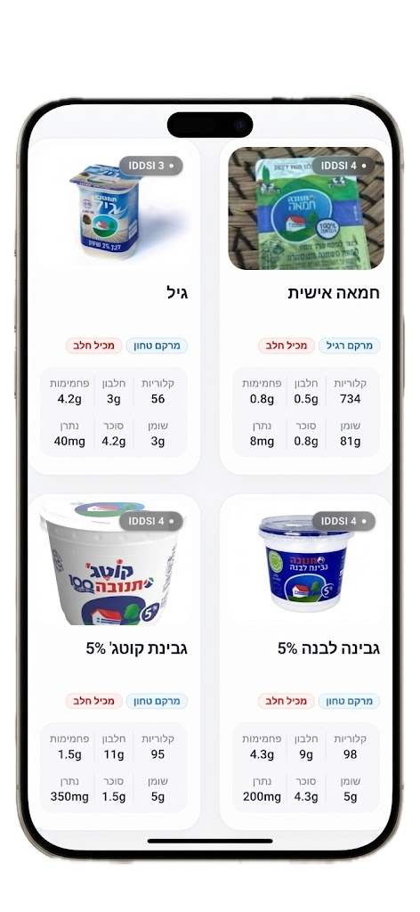

| Computer Science
Tomer Natan, Mishel Svirsky
Advisor: Dr. Sharon Yalov-Handzel
Client: Meir Medical Center (Maggie Weinstein, Eyal Assulin, Galit Halfon)
NutriCheck - A Hospital Dietitian Management System
3. Architecture
1. Problem description
The hospital currently relies on Excel files
Difficult data maintenance
Finding the right food information takes too much time
Staff must make quick decisions during busy hours
Limited Mobile Accessibility
Allergy mistakes can happen easily
Confusing User Interface
Manual Data Lookup
Peak Pressure
Risk Of Errors
2. The Solution
NutriCheck: A professional digital platform that manages hospitals menus and allergen filtering in real-time.
4. Engineering challenge
Natural Language Search (NLP)
Intuitive UI for Line Workers
ML-Based Product Recommendations
Building a fast allergy filtering system assisted by ML
Preventing food and allergen data errors
Keeping the interface simple during busy work hours
Z-Score Anomaly Detection
Allergy &Texture Filters
Mobile Control
Implementing web systems with hospital regulations
Optimizing the system for easy mobile use
Streamlining complex nutritional data maintenance
Easy Meal Builder
Benefits: No more messy Excel files. Our system makes the kitchen line work faster and lets dietitians manage everything easily from their phones.
Client

